Slide 1
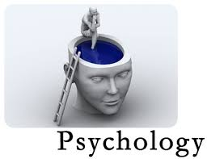
What is Psychology?

Slide 2
Psychology
Psychology is the science that studies behavior and the physiological and mental processes that underlie it, and it is the profession that applies the accumulated knowledge of this science to practical problems

Slide 3
Psychology
Psychology is the science that studies behavior and the physiological and mental processes that underlie it, and it is the profession that applies the accumulated knowledge of this science to practical problems

Slide 4
What is Science?
“Science is defined as a branch of knowledge or study dealing with a body of facts and truth systematically arranged.”

Slide 5
Scientific Theory?
A reasoned explanation tested by many observations and experiments
Tells why things are…

Slide 6
Three things
Must explain clearly and simply
Must be repeatable
Must be able to make predictions
Theories can be changed or modified by new evidence

Slide 7
Psychology is the science that studies behavior and the physiological and mental processes that underlie it, and it is the profession that applies the accumulated knowledge of this science to practical problems

Slide 8
Psychology is the science that studies behavior and the physiological and mental processes that underlie it, and it is the profession that applies the accumulated knowledge of this science to practical problems

Slide 9
Psychology
It is a scientific way of studying human behavior
It is a comprehensive discipline
It uses variety of methods to study a research question
It is pragmatic in approach: Intuitive or naive psychologist

Slide 10
Scientific Theory?
Describe
Explain
Predict
Control
Improve

Slide 11
Goals of Psychology
Describe: It describes what happens in an objective manner
Empirical in approach
Data driven
Operational definition

Slide 12
Explain: Provides explanation of an event
Predict
Control
Improve: Enhancing quality of life

Slide 13
Experimental Method
Goal: To examine whether a specific variable influences or determine some aspect of other specific variable
X Y
Cause Effect
IV DV
Predictor Predicted Behaviour

Slide 14
Main Features of Experimental Method
Hypothesis: Tentative solution of a research question
Null Hypothesis
Experimental Hypothesis
Directional
Non Directional

Slide 15
Independent Variable (IV): The Variable that can be systematically varied by the researcher in a specified direction
Dependent Variable: The variable that is measured
Randomization: The possibility of assigning a subject to different treatment groups would be equal

Slide 16
Systematic Variation: Manipulation of IV in such a way so that variation in DV can be attributed to variation in IV
Control: An experiment should contain a control group. Control group provides a baseline against which the effect of different independent treatment groups can be compared
Controlling the extraneous variable
Replication: Repeated investigation should produce comparable results
Drawing Conclusions

Slide 17
Experimental Design: An Example
Population
B.Tech Students
Experimental
Group
Control Group
Groups
Self Study
Pretest
Self Study
Experimental Treatment
Coaching
for a month
Performance
Post-Test
Performance
Success Rate
Post Test – Pre Test
Success rate

Slide 18
Lets brainstorm regarding what you all think a psychologist study?

Slide 19
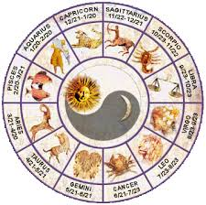
Go to the horoscope section of the newspaper and read your horoscope.
Observations?

Slide 20
The Barnum Effect
The tendency to believe general personality reports such as horoscopes. Named after P.T. Barnum, who once said a good circus should “have something for everyone.” Horoscopes work the same way.
What do you think?
What is the basic way in which psychology differs from false sciences?
Why do you think false sciences are so widespread?

Slide 21
A Social Science vs. a False Science
Psychology is a social science based on verifiable evidence and theories that are tested according to the scientific method. False sciences, on the other hand, do not rely on verifiable evidence.

Slide 22
Correlational Research
It focuses upon studying the research problems in real life setting
Used when systematic variation in one variable is not impossible
Ethical issues: e.g., Exposure to violence and Aggression

Slide 23
A systematic observation of two or more variables
It aims to study whether changes in one variable are accompanied by changes in other variable
Range from +1 to -1
.
observation

Slide 24
It does not say anything about “cause –effect” relationship between variables as in experimental method
Types of Correlational research
Observation
Case Studies
Surveys

Slide 25
Observation
Two Types: Participant & Non-Participant
Non-participant Observation: Naturalistic observation
A careful observation of an event or behaviour without intervening directly with the subjects.
Participant Observation
Researcher intensively involve/ immerse himself with the target population in order to understand an issue/ problem in an in-depth manner over a long period of time.

Slide 26
Case Study
In-depth investigation of an individual participant
Especially used in clinical settings
Results cannot be generalized to a larger population
Unlike experimental method, behavioural control is not possible in case study
Case study focuses on contemporary events

Slide 27
Survey
Structured questionnaires are used to measure specific aspect of an event or behaviour
It provides a way to gather information which is not directly observable

Slide 28
Historical Perspective
Psychology is as old as human history.
Written account of the interest in people’s actions, motives, and thoughts can be traced to ancient times.

Slide 29
Ancient Greece
The Middle Ages
Socrates developed a method of learning called introspection, which means to carefully examine our own thoughts and feelings.
Aristotle outlined associationism, the theory that association with past experiences is a basic principle of mental activity.
Most Europeans of this period believed that psychological problems were caused by possession by demons
They used certain tests to determine whether a person was possessed.

Slide 30
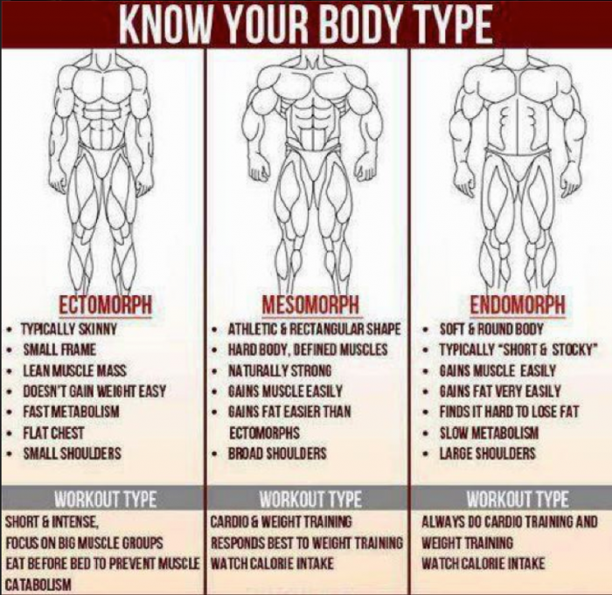
Sheldon’s Somatotype

Slide 31
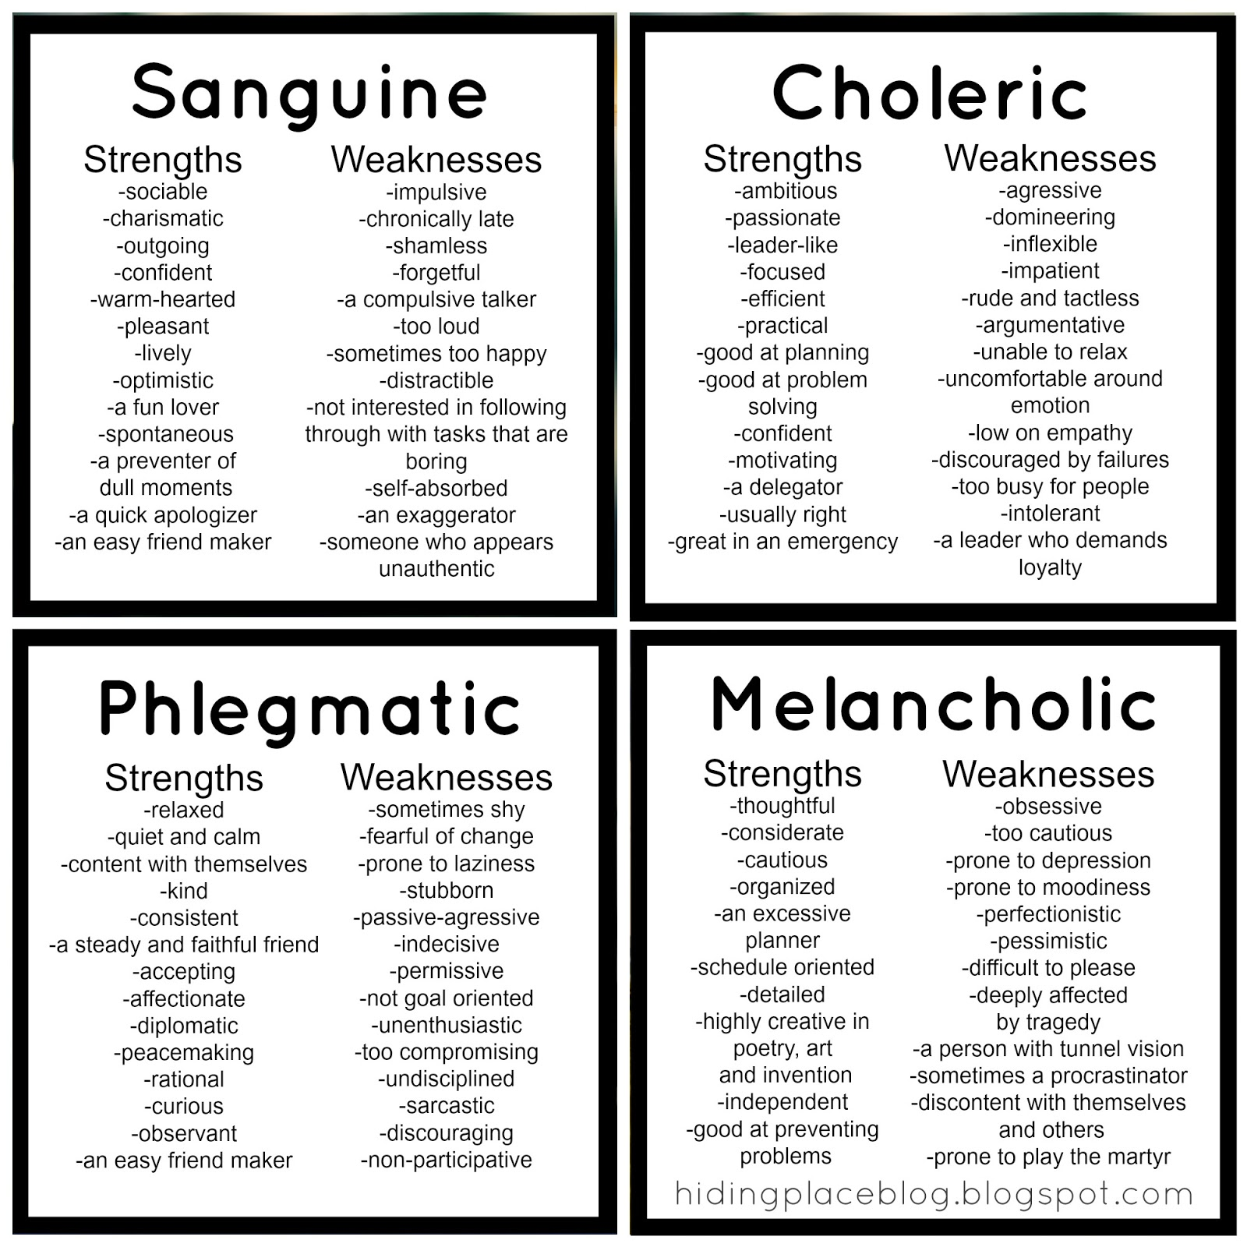
Hippocrates Personality Type

Slide 32
Early Days: Branch of philosophy
Psychology as a Science: Setup a lab in 1879 in Leipzig, Germany
Father of Psychology: Whilhelm Wundt

Slide 33
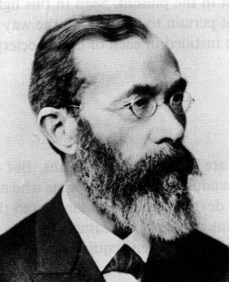
Structuralism
Wundt and Titchner
Focus of the study: Structure of mental processes
Analysis of experience in terms of its ‘elements’, ‘specific components’ or ‘building blocks’
Methods of Analysis: Introspection
Observing and reporting mental processes, feelings, and experiences as accurately as possible
Criticism: lack of objectivity

Slide 34
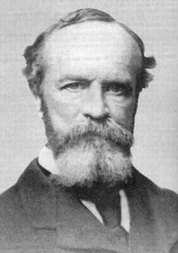
Functionalism
William James: Broadened the scope of Psychology
Published a book on Principles of Psychology
Focus of the study: How mind functions to adapt us to our environment
Influenced by Darwinian's theory of natural selection
Impact of functionalism on Psychology: Study of animals, educational psychology, industrial psychology

Slide 35
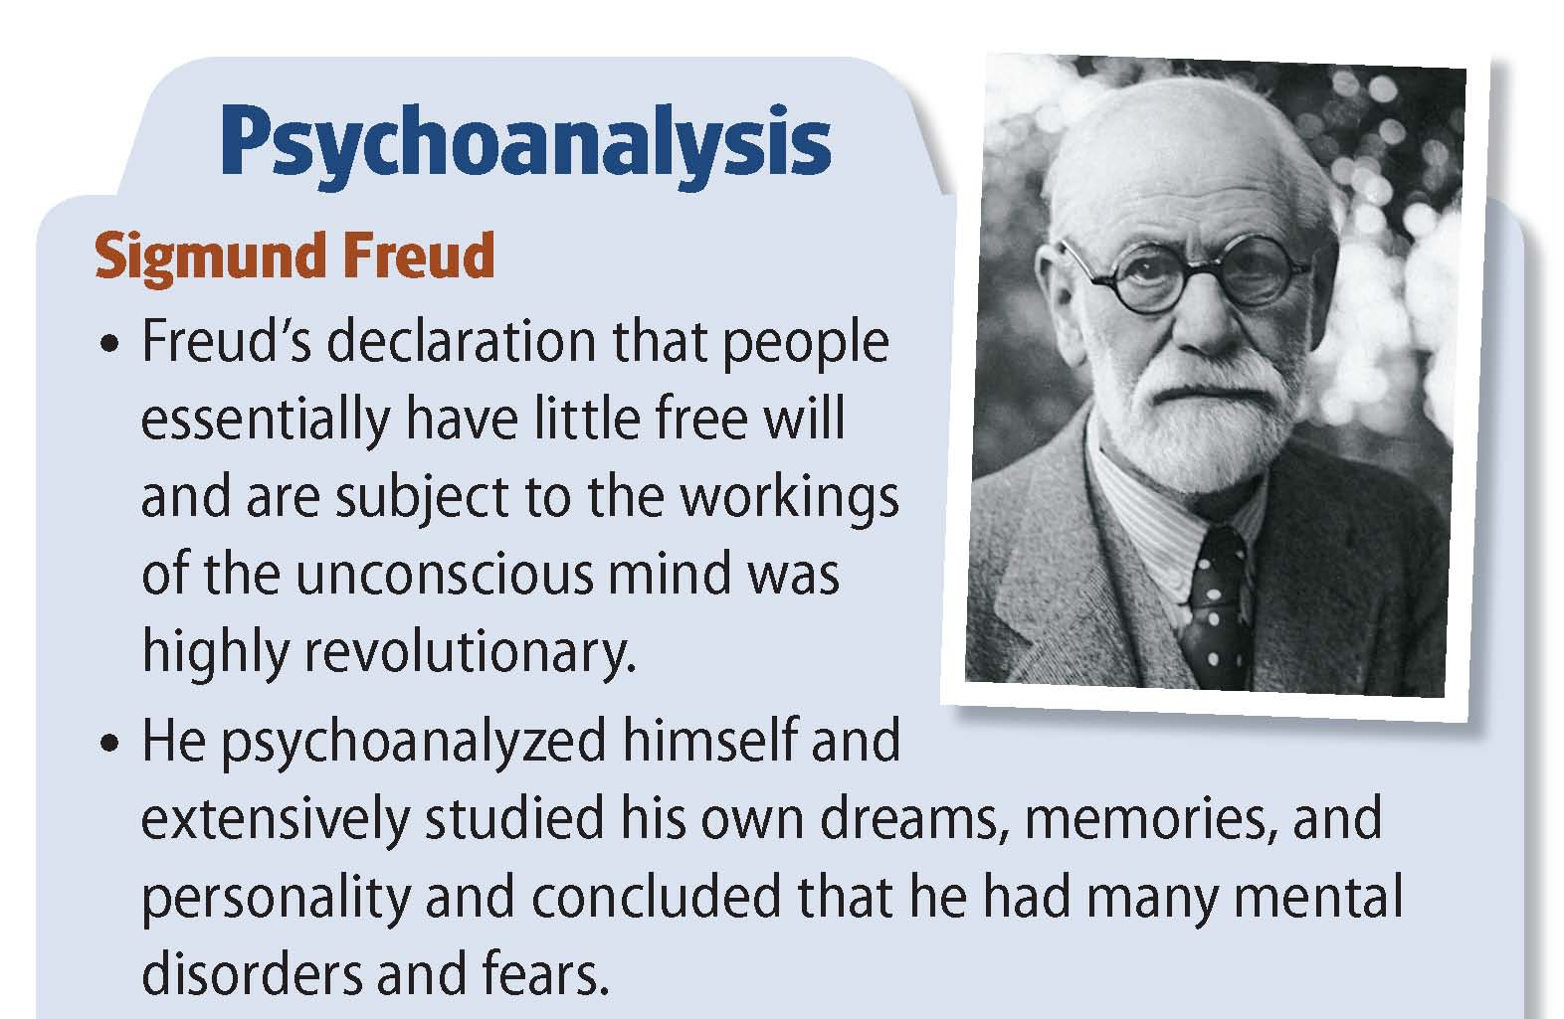

Slide 36
Sigmund Freud and Psychoanalysis
He theorized that the key to human behavior is satisfying desires.
Freud was the most famous of the early psychologists.
He developed psychoanalysis, which emphasizes unconscious motives and internal conflicts in human behavior.
He developed psychodynamic thinking, which assumes that most of what exists in an individual's mind is unconscious and consists of conflicting impulses, urges, and wishes.

Slide 37
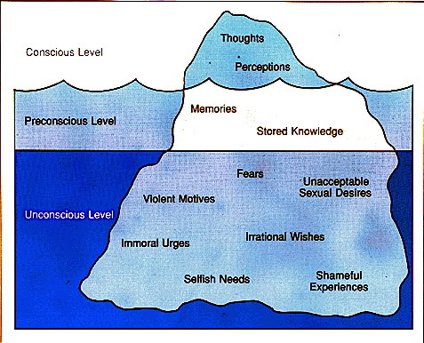
“Freud’s Iceberg”

Slide 38
Mind and iceberg: Three levels of Mind
Conscious
Subconscious
Unconscious
Structure of Personality:
ID: Pleasure Principle
EGO: Reality Principle (Executive of Personality )
Superego: Moral Principles
Types of Anxiety:
Id x Ego: Neurotic Anxiety
Superego x Ego: Moral Anxiety

Slide 39
Defense Mechanism
Ego defenses are not necessarily unhealthy as one thinks.
In fact, the lack of these defenses, or the inability to use them effectively can often lead to problems in life.
However, we sometimes employ the defenses at the wrong time or overuse them, which can be equally destructive.

Slide 40
Denial: arguing against an anxiety provoking stimuli by stating it doesn't exist. Denying that your physician's diagnosis of cancer is correct and seeking a second opinion.
Displacement: taking out impulses on a less threatening target. Slamming a door instead of hitting as person, yelling at your spouse after an argument with your boss
Intellectualization: avoiding unacceptable emotions by focusing on the intellectual aspects. Focusing on the details of a funeral as opposed to the sadness and grief

Slide 41
Projection: Placing unacceptable impulses in yourself onto someone else. E.g. when losing an argument, you state "You're just Stupid ! Rationalization: Supplying a logical or rational reason as opposed to the real reason. stating that you were fired because you didn't kiss up the the boss, when the real reason was your poor performance Reaction Formation: taking the opposite belief because the true belief causes anxiety. having a bias against a particular race or culture and then embracing that race or culture to the extreme

Slide 42
Behaviourism
John B.Watson: Objected the study of mind or conscious experience
Criticized the method of Introspection
Behaviourists advocated the study of overt, observable behaviour
Studied the relationship between stimuli (event) and response
Used Pavlov’s concept of ‘conditioning’ to explain behaviour

Slide 43
Radical Behaviourism: B.F. Skinner
Behaviour is learned and maintained by its consequences
Positive reinforcement vs. Negative reinforcement
Cognitive Behaviourism
Advocated the role of thinking and other mental processes

Slide 44
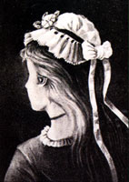
Gestalt Psychology
It emphasized the study of thinking, learning, and perception in whole units, not by analysis into parts
Gestalt Principles : Law of similarity, continuation, closure, symmetry etc.
This may seem like one picture,
but it can be perceived as 3 different faces.
Can you find them?

Slide 45
Humanistic Psychology
It emphasizes understanding a human from his own eyes
Rejected the Freudian idea that behaviour is governed by unconscious forces
Criticized behaviourists view of conditioning
It places high value for human potentials
“ People can freely choose to live more creative, meaningful and satisfying life’

Slide 46
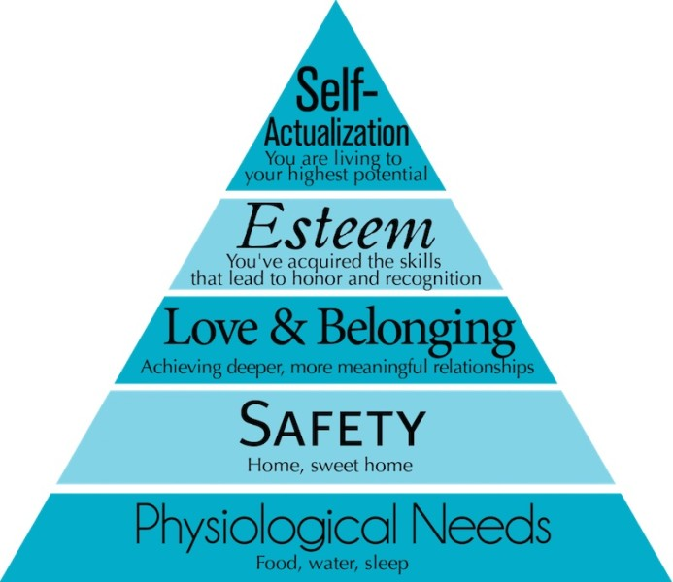

Slide 47
Subfields and Applications of Psychology
Developmental Psychology: Deals with how people change physically, cognitively, and socially across life span
Educational Psychology: Deals with all the aspects of educational process such as, mode of teaching and instruction, techniques of instruction, learning disability etc.
Cognitive Psychology: Deals with all the aspects of cogition such as, learning, memory, thinking, reasoning, decision making etc.
Industrial/ Organizational Psychology: Studies all aspect of behaviour in organizational setup such as, how to improve the productivity of employees, training programme for employees, designing a system of performance appraisal

Slide 48
Psychobiology: Investigate the biological basis of behaviour
Social Psychology: How social context affects the behavior of the individual and groups. It takes into account all aspects of social behaviour and and thought.
Experimental Psychology: Deals with all aspects of basic psychological processes such as, perception, learning, thnking, motivation etc.
Health or Medical Psychology: Aims to study the role of psychological factors in influencing and marinating physical health. It also emphasizes the promotion of good physical health
Abnormal Psychology: Deals with various forms of psychopathology
Clinical Psychologists: Deals with the diagnosis and treatment of psychological disorders

Slide 49
Environmental Psychology: Deals with the relationship between humans and the physical environment
Engineering Psychology: Deals with designing machines, products, services or tasks considering human limitations
Forensic Psychology: Deals with the possible association between psychopathology and criminal behaviour

